Slide 1
Recursive Search
Sharan Krishnan

Slide 2
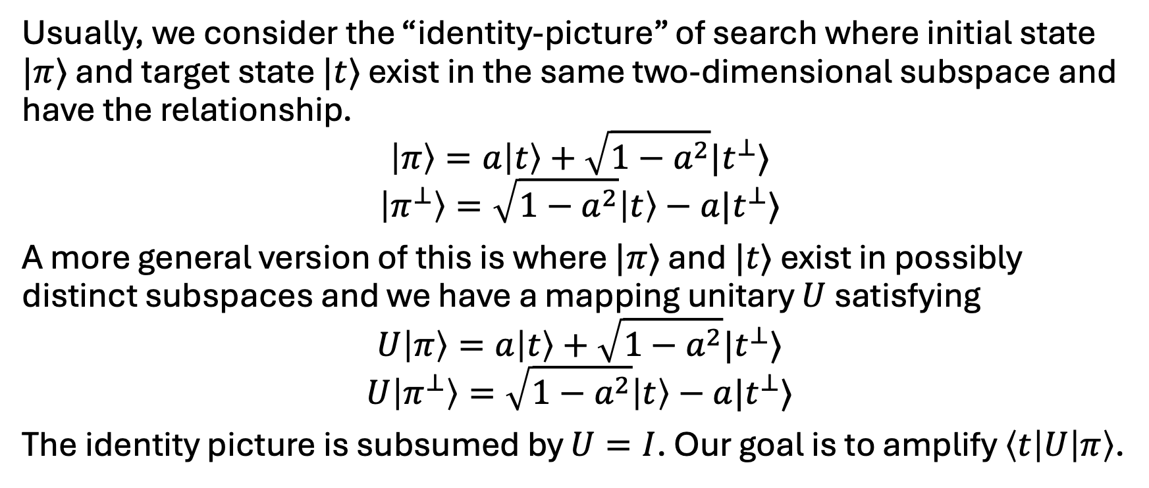
Generalised search problem
Usually, we consider the “identity-picture” of search where initial state $|π⟩$ and target state $|t⟩$ exist in the same two-dimensional subspace and have the relationship.
$$\left|π\right\rangle =a\left|t\right\rangle +\sqrt{1−a^{2}}|t^{⊥}⟩$$
$$\left|π^{⊥}\right\rangle =\sqrt{1−a^{2}}\left|t\right\rangle −a|t^{⊥}⟩$$
A more general version of this is where $|π⟩$ and $|t⟩$ exist in possibly distinct subspaces and we have a mapping unitary $U$ satisfying
$$U\left|π\right\rangle =a\left|t\right\rangle +\sqrt{1−a^{2}}|t^{⊥}⟩$$
$$U\left|π^{⊥}\right\rangle =\sqrt{1−a^{2}}\left|t\right\rangle −a|t^{⊥}⟩$$
The identity picture is subsumed by $U=I$. Our goal is to amplify $\left\langle t\left|U\right|π\right\rangle$.

Slide 3
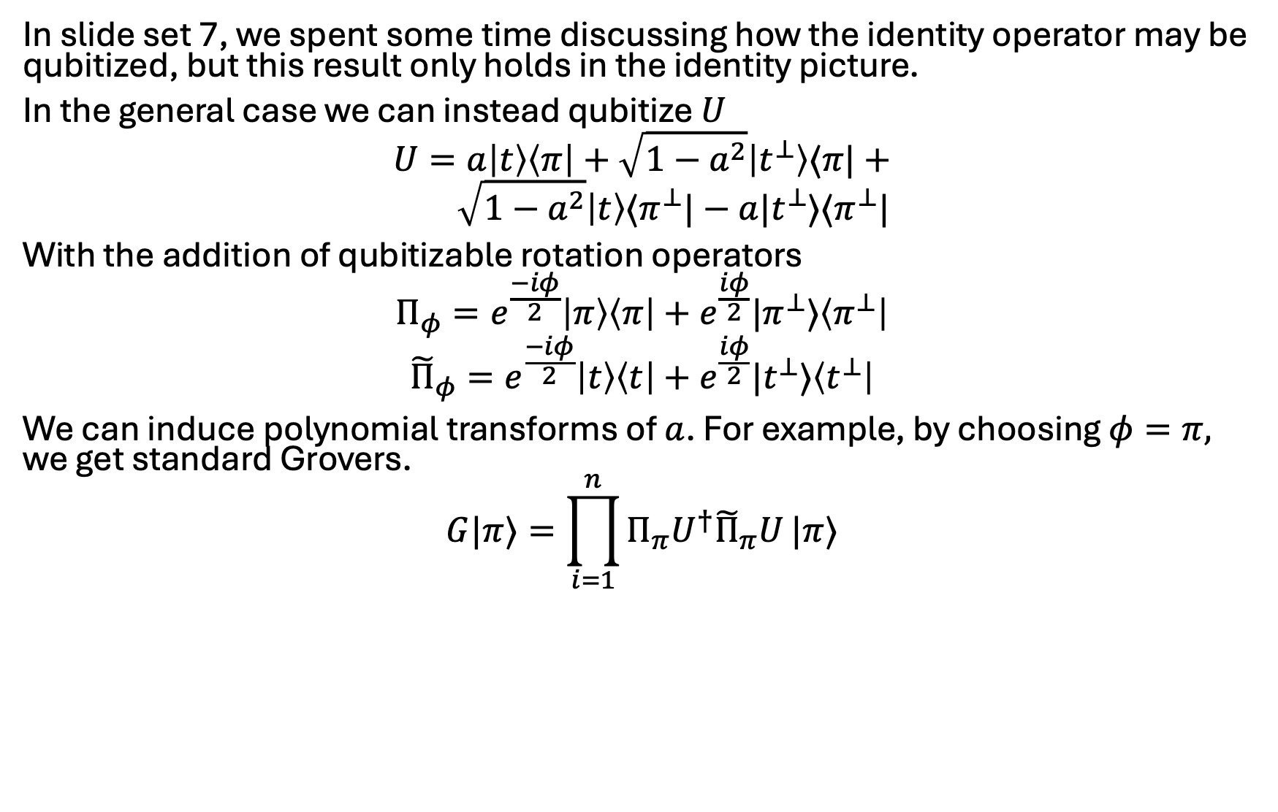

Mistake from slide set 7: over-emphasis on $I$
In slide set 7, we spent some time discussing how the identity operator may be qubitized, but this result only holds in the identity picture.
In the general case we can instead qubitize $U$
$$U=a\left|t\right\rangle \left\langle π\right|+\sqrt{1−a^{2}}\left|t^{⊥}\right\rangle ⟨π|+ \\ \sqrt{1−a^{2}}\left|t\right\rangle ⟨π^{⊥}|−a|t^{⊥}⟩⟨π^{⊥}|$$
With the addition of qubitizable rotation operators
$$Π_{φ}=e^{\frac{−iφ}{2}}\left|π\right\rangle \left\langle π\right|+e^{\frac{iφ}{2}}|π^{⊥}⟩\left\langle π^{⊥}\right|$$
$${\tilde{Π}}_{φ}=e^{\frac{−iφ}{2}}\left|t\right\rangle \left\langle t\right|+e^{\frac{iφ}{2}}|t^{⊥}⟩\left\langle t^{⊥}\right|$$
We can induce polynomial transforms of $a$. For example, by choosing $φ=π,$ we get standard Grovers.
$$G|π⟩=\prod_{i=1}^{n}{Π_{π}U^{†}{\tilde{Π}}_{π}U}|π⟩$$

Slide 4
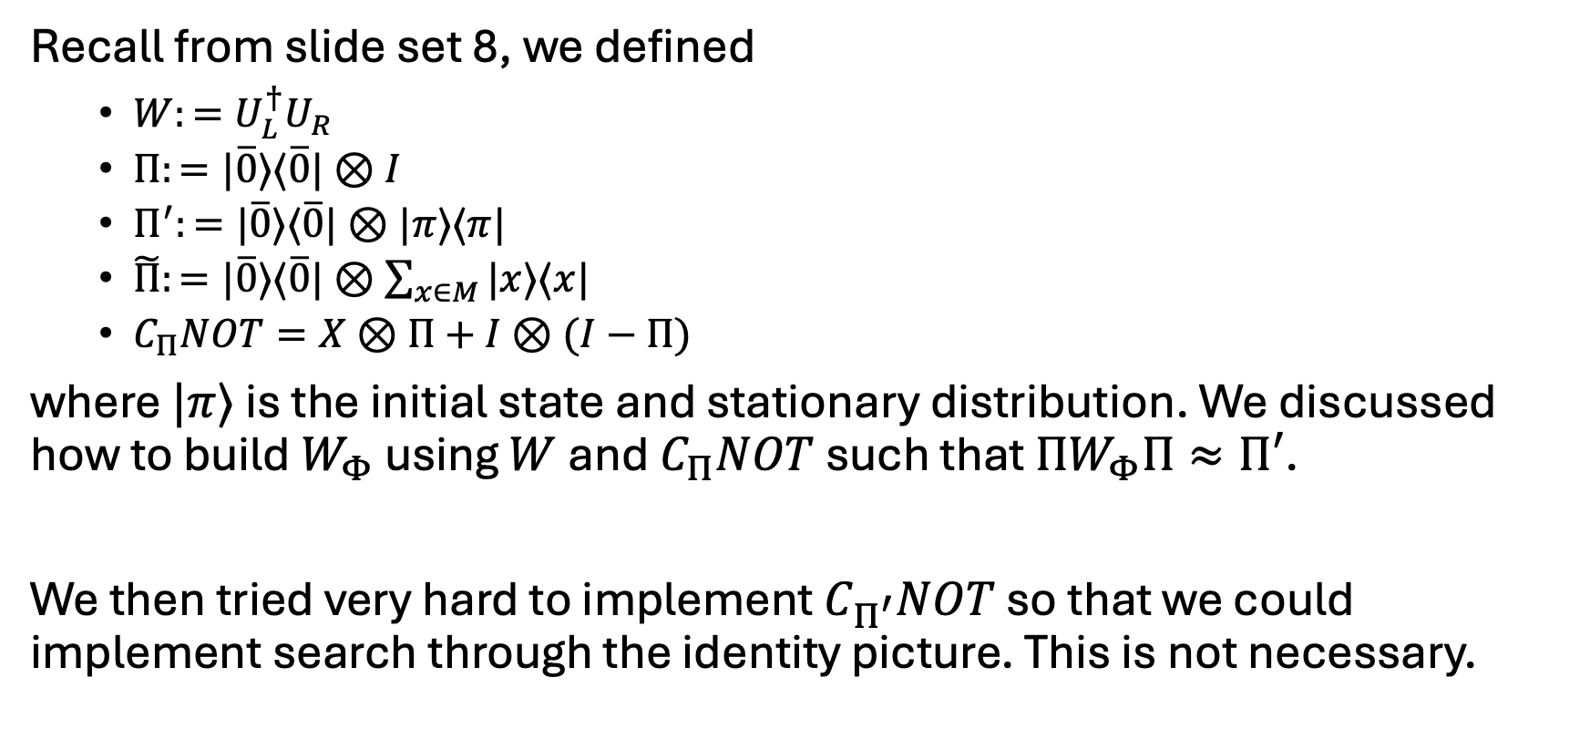

Mistake from slide set 8: the elusive $C_{Π^{′}}NOT$
Recall from slide set 8, we defined
$W:=U_{L}^{†}U_{R}$
$Π:=|\overline{0}⟩⟨\overline{0}|⊗I$
$Π^{′}:=|\overline{0}⟩⟨\overline{0}|⊗|π⟩⟨π|$
$\tilde{Π}:=|\overline{0}⟩⟨\overline{0}|⊗\sum_{x∈M}{|x⟩⟨x|}$
$C_{Π}NOT=X⊗Π+I⊗(I−Π)$
where $|π⟩$ is the initial state and stationary distribution. We discussed how to build $W_{Φ}$ using $W$ and$C_{Π}NOT$ such that $ΠW_{Φ}Π≈Π′$.
We then tried very hard to implement $C_{Π^{′}}NOT$ so that we could implement search through the identity picture. This is not necessary.

Slide 5
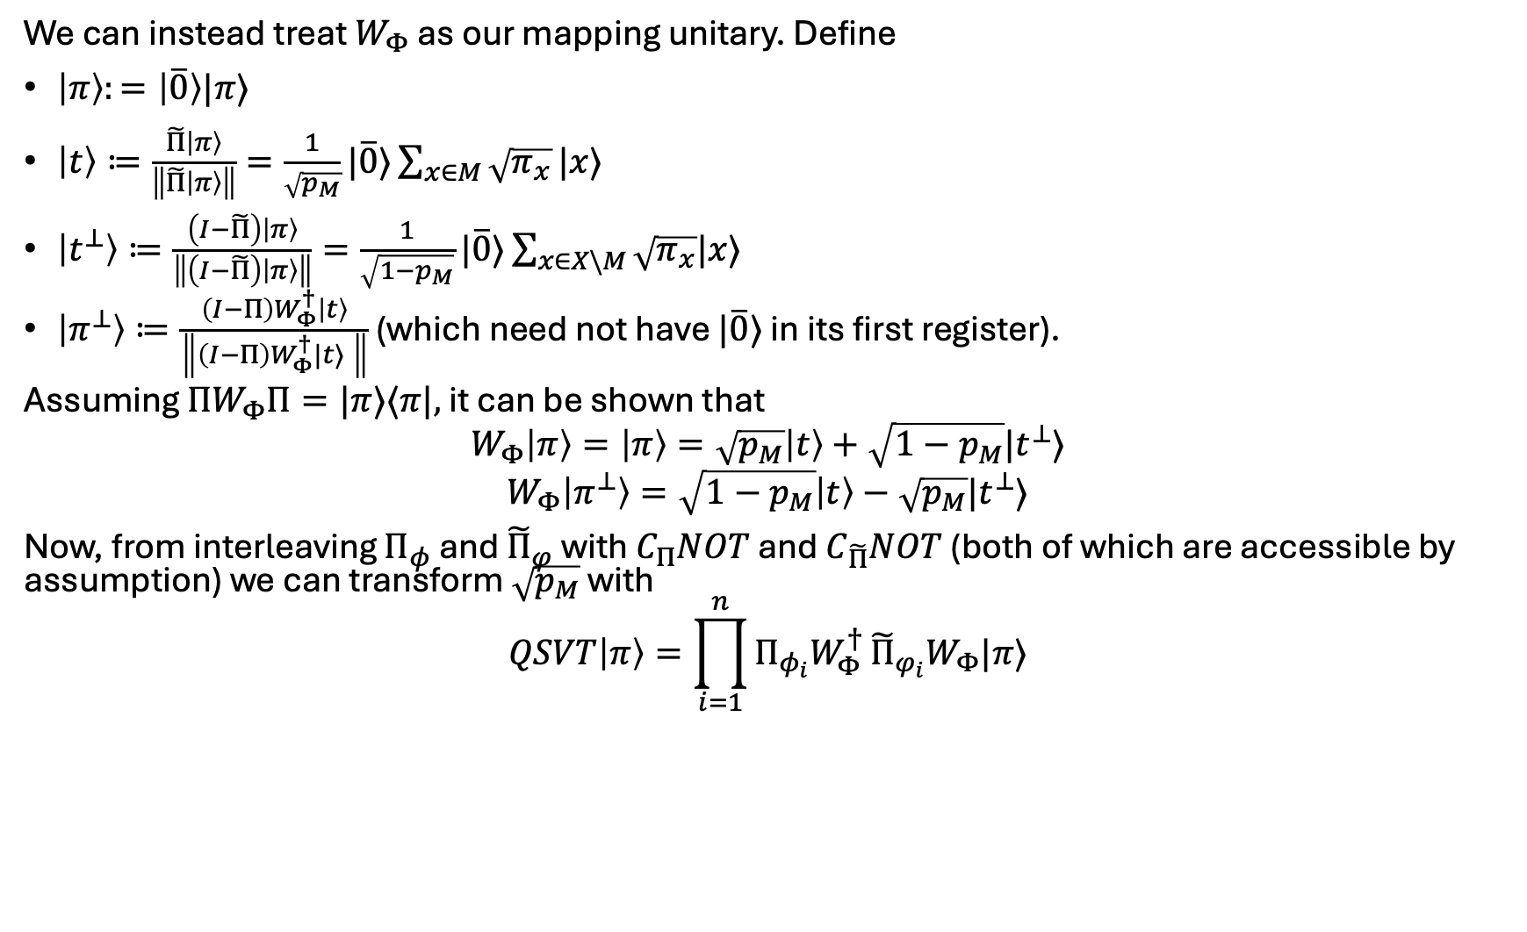
Reformulating QSVT based MNRS search
We can instead treat $W_{Φ}$ as our mapping unitary. Define
$\left|π\right\rangle :=\left|\overline{0}\right\rangle |π⟩$
$\left|t\right\rangle ≔\frac{\tilde{Π}\left|π\right\rangle }{\left\|\tilde{Π}\left|π\right\rangle \right\|}=\frac{1}{\sqrt{p_{M}}}|\overline{0}⟩\sum_{x∈M}{\sqrt{π_{x}}}|x⟩$
$\left|t^{⊥}\right\rangle ≔\frac{\left(I−\tilde{Π}\right)\left|π\right\rangle }{\left\|\left(I−\tilde{Π}\right)\left|π\right\rangle \right\|}=\frac{1}{\sqrt{1−p_{M}}}|\overline{0}⟩\sum_{x∈X\backslash M}{\sqrt{π_{x}}|x⟩}$
$\left|π^{⊥}\right\rangle ≔\frac{\left(I−Π\right)W_{Φ}^{†}\left|t\right\rangle }{\left\|\left(I−Π\right)W_{Φ}^{†}|t⟩ \right\|}$ (which need not have $|\overline{0}⟩$ in its first register).
Assuming $ΠW_{Φ}Π=|π⟩⟨π|,$ it can be shown that
$$W_{Φ}\left|π\right\rangle =\left|π\right\rangle =\sqrt{p_{M}}\left|t\right\rangle +\sqrt{1−p_{M}}|t^{⊥}⟩$$
$$W_{Φ}\left|π^{⊥}\right\rangle =\sqrt{1−p_{M}}\left|t\right\rangle −\sqrt{p_{M}}|t^{⊥}⟩$$
Now, from interleaving $Π_{φ}$ and ${\tilde{Π}}_{φ}$ with $C_{Π}NOT$ and $C_{\tilde{Π}}NOT$ (both of which are accessible by assumption) we can transform $\sqrt{p_{M}}$ with
$$QSVT\left|π\right\rangle =\prod_{i=1}^{n}{Π_{φ_{i}}W_{Φ}^{†}}{\tilde{Π}}_{φ_{i}}W_{Φ}|π⟩$$

Slide 6
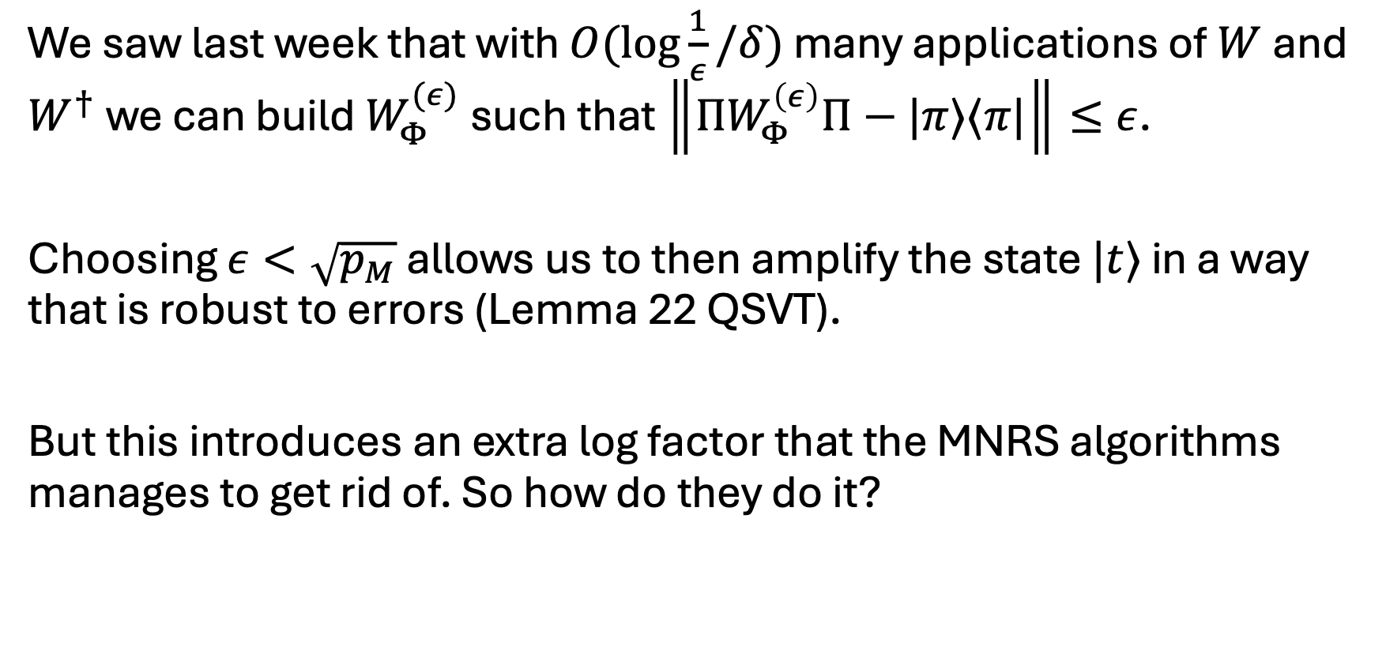
Resolving errors
We saw last week that with $O(\log{\frac{1}{ε}/δ)}$ many applications of $W$ and $W^{†}$ we can build $W_{Φ}^{(ε)}$ such that $\left\|{ΠW}_{Φ}^{\left(ε\right)}Π−|π⟩⟨π|\right\|≤ε$.
Choosing $ε<\sqrt{p_{M}}$ allows us to then amplify the state $|t⟩$ in a way that is robust to errors (Lemma 22 QSVT).
But this introduces an extra log factor that the MNRS algorithms manages to get rid of. So how do they do it?

Slide 7
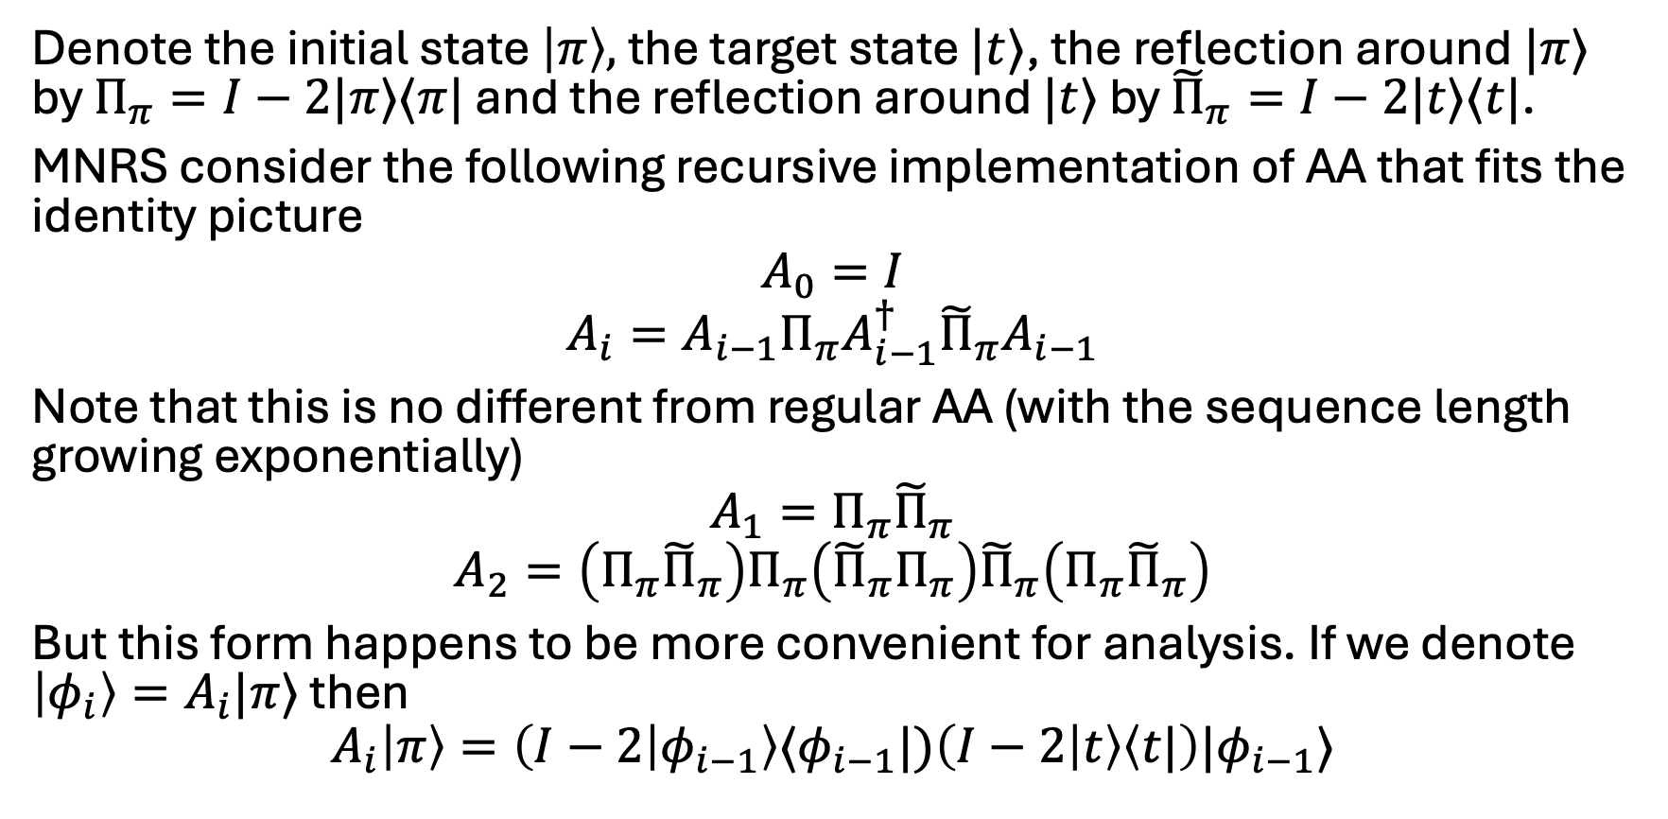
Recursive amplitude amplification
Denote the initial state $\left|π\right\rangle ,$ the target state $|t⟩$, the reflection around $|π⟩$ by $Π_{π}=I−2|π⟩⟨π|$ and the reflection around $|t⟩$ by ${\tilde{Π}}_{π}=I−2|t⟩⟨t|$.
MNRS consider the following recursive implementation of AA that fits the identity picture
$$A_{0}=I$$
$$A_{i}=A_{i−1}Π_{π}A_{i−1}^{†}{\tilde{Π}}_{π}A_{i−1}$$
Note that this is no different from regular AA (with the sequence length growing exponentially)
$$A_{1}=Π_{π}{\tilde{Π}}_{π}$$
$$A_{2}=\left(Π_{π}{\tilde{Π}}_{π}\right)Π_{π}\left({\tilde{Π}}_{π}Π_{π}\right){\tilde{Π}}_{π}\left(Π_{π}{\tilde{Π}}_{π}\right)$$
But this form happens to be more convenient for analysis. If we denote $\left|φ_{i}\right\rangle =A_{i}|π⟩$ then
$$A_{i}\left|π\right\rangle =\left(I−2 | φ_{i−1}\right\rangle ⟨φ_{i−1}|)\left(I−2 | t\right\rangle \left\langle t|\right)|φ_{i−1}⟩$$

Slide 8
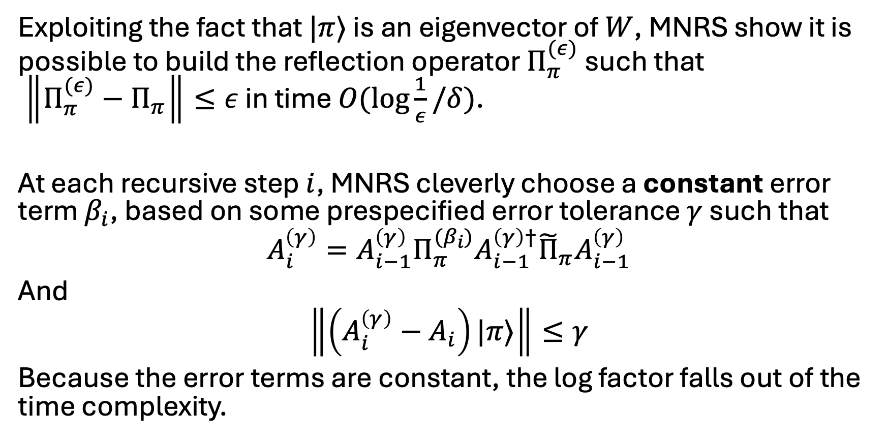
Relationship to quantum walk search
Exploiting the fact that $|π⟩$ is an eigenvector of $W$, MNRS show it is possible to build the reflection operator $Π_{π}^{(ε)}$ such that $\left\|Π_{π}^{(ε)}−Π_{π}\right\|≤ε$ in time $O(\log{\frac{1}{ε}/δ)}$.
At each recursive step $i$, MNRS cleverly choose a constant error term $β_{i}$, based on some prespecified error tolerance $γ$ such that
$$A_{i}^{\left(γ\right)}=A_{i−1}^{\left(γ\right)}Π_{π}^{{(β}_{i})}A_{i−1}^{\left(γ\right)†}{\tilde{Π}}_{π}A_{i−1}^{\left(γ\right)}$$
And
$$\left\|\left(A_{i}^{\left(γ\right)}−A_{i}\right)|π⟩\right\|≤γ$$
Because the error terms are constant, the log factor falls out of the time complexity.

Slide 9
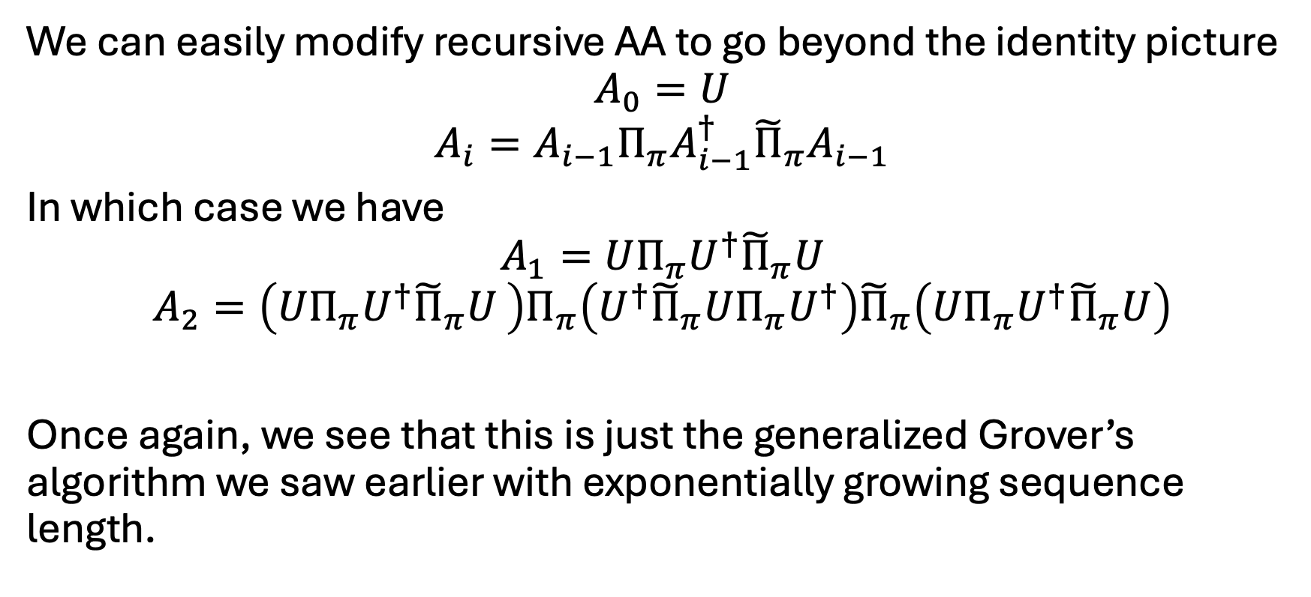
Generalising recursive AA
We can easily modify recursive AA to go beyond the identity picture
$$A_{0}=U$$
$$A_{i}=A_{i−1}Π_{π}A_{i−1}^{†}{\tilde{Π}}_{π}A_{i−1}$$
In which case we have
$$A_{1}=UΠ_{π}U^{†}{\tilde{Π}}_{π}U$$
$$A_{2}=\left(UΠ_{π}U^{†}{\tilde{Π}}_{π}U \right)Π_{π}\left(U^{†}{\tilde{Π}}_{π}U{Π_{π}U}^{†}\right){\tilde{Π}}_{π}\left(UΠ_{π}U^{†}{\tilde{Π}}_{π}U\right)$$
Once again, we see that this is just the generalized Grover’s algorithm we saw earlier with exponentially growing sequence length.

Slide 10
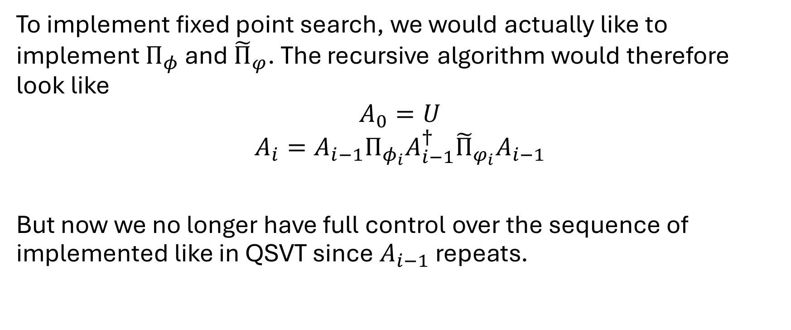
Complication 1
To implement fixed point search, we would actually like to implement $Π_{φ}$ and ${\tilde{Π}}_{φ}$. The recursive algorithm would therefore look like
$$A_{0}=U$$
$$A_{i}=A_{i−1}Π_{φ_{i}}A_{i−1}^{†}{\tilde{Π}}_{φ_{i}}A_{i−1}$$
But now we no longer have full control over the sequence of implemented like in QSVT since $A_{i−1}$ repeats.

Slide 11
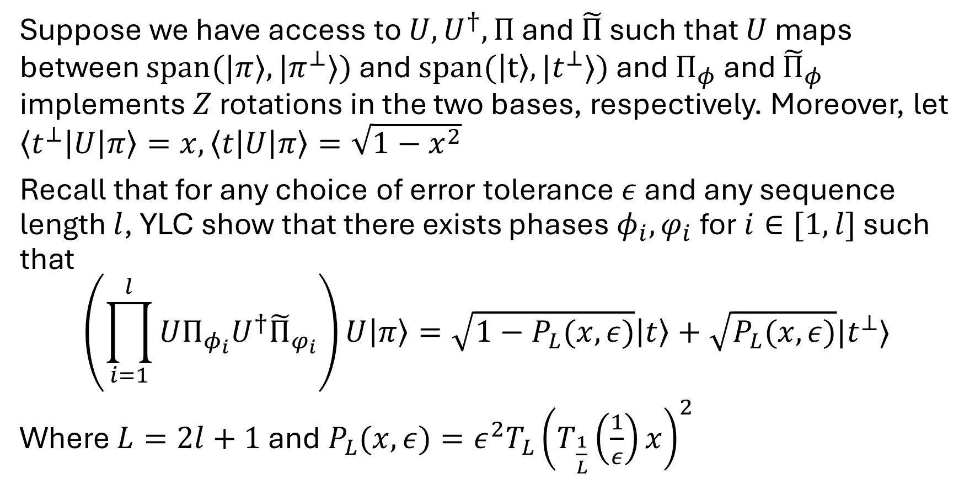
Solution: YLC FP search
Suppose we have access to $U,U^{†}, Π$ and $\tilde{Π}$ such that $U$ maps between $span(|π⟩,|π^{⊥}⟩)$ and $span(\left|t\right\rangle ,|t^{⊥}⟩)$ and $Π_{φ}$ and ${\tilde{Π}}_{φ}$ implements $Z$ rotations in the two bases, respectively. Moreover, let $\left\langle t^{⊥}\left|U\right|π\right\rangle =x,\left\langle t\left|U\right|π\right\rangle =\sqrt{1−x^{2}}$
Recall that for any choice of error tolerance $ε$ and any sequence length $l$, YLC show that there exists phases $φ_{i},φ_{i}$ for $i∈[1,l]$ such that
$$\left(\prod_{i=1}^{l}{UΠ_{φ_{i}}U^{†}{\tilde{Π}}_{φ_{i}}}\right)U\left|π\right\rangle =\sqrt{1−P_{L}(x,ε)}\left|t\right\rangle +\sqrt{P_{L}(x,ε)}|t^{⊥}⟩$$
Where $L=2l+1$ and$P_{L}(x, ε)=ε^{2}T_{L}{\left(T_{\frac{1}{L}}\left(\frac{1}{ε}\right)x\right)}^{2}$

Slide 12
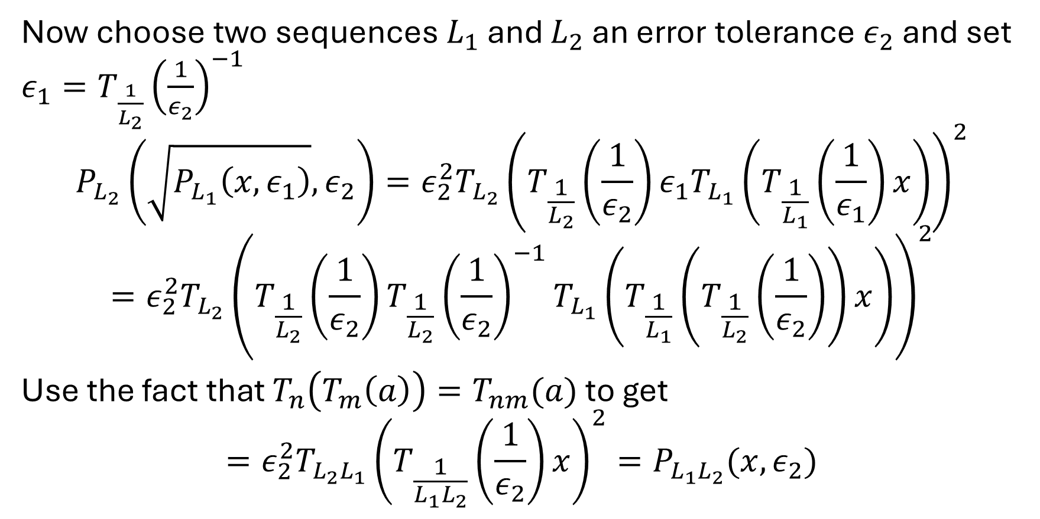
Solution: YLC FP search
Now choose two sequences $L_{1}$ and $L_{2}$ an error tolerance $ε_{2}$ and set $ε_{1}=T_{\frac{1}{L_{2}}}{\left(\frac{1}{ε_{2}}\right)}^{−1}$
$$P_{L_{2}}\left(\sqrt{P_{L_{1}}\left(x,ε_{1}\right)},ε_{2}\right)=ε_{2}^{2}T_{L_{2}}{\left(T_{\frac{1}{L_{2}}}\left(\frac{1}{ε_{2}}\right)ε_{1}T_{L_{1}}\left(T_{\frac{1}{L_{1}}}\left(\frac{1}{ε_{1}}\right)x\right)\right)}^{2}$$
$$=ε_{2}^{2}T_{L_{2}}{\left(T_{\frac{1}{L_{2}}}\left(\frac{1}{ε_{2}}\right)T_{\frac{1}{L_{2}}}{\left(\frac{1}{ε_{2}}\right)}^{−1}T_{L_{1}}\left(T_{\frac{1}{L_{1}}}\left(T_{\frac{1}{L_{2}}}\left(\frac{1}{ε_{2}}\right)\right)x\right)\right)}^{2}$$
Use the fact that $T_{n}\left(T_{m}\left(a\right)\right)=T_{nm}(a)$ to get
$$=ε_{2}^{2}T_{L_{2}L_{1}}{\left(T_{\frac{1}{L_{1}L_{2}}}\left(\frac{1}{ε_{2}}\right)x\right)}^{2}=P_{L_{1}L_{2}}(x,ε_{2})$$

Slide 13
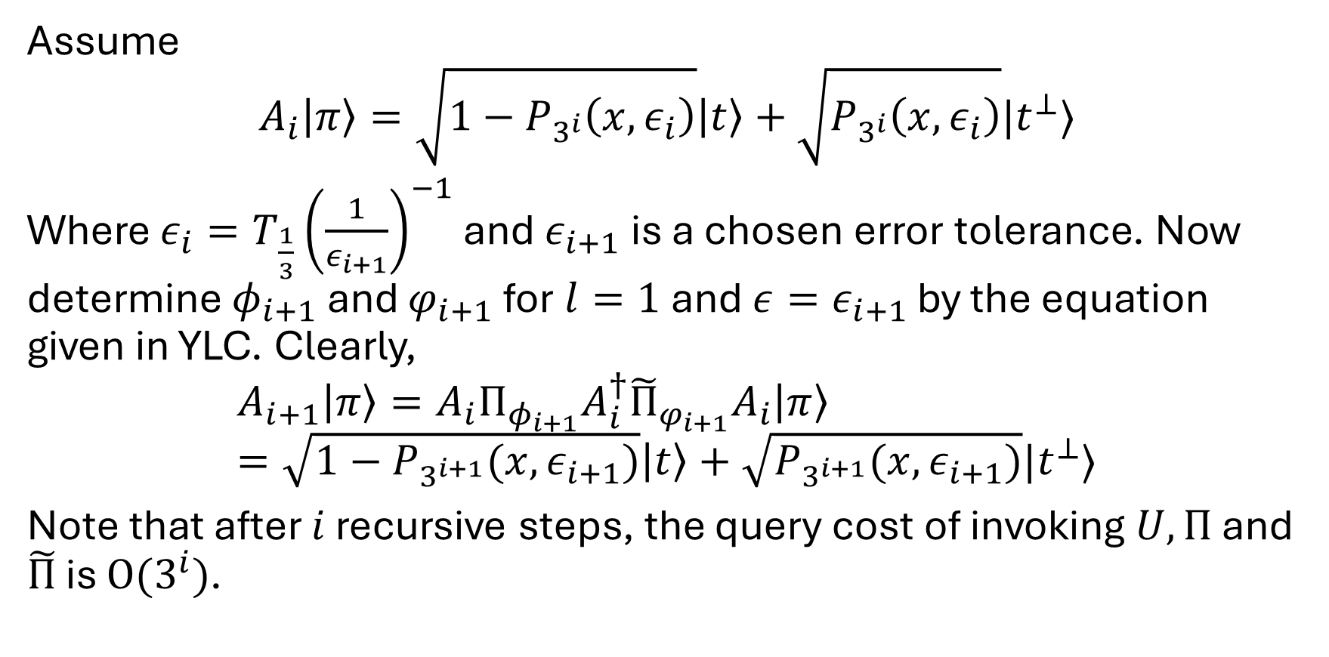
Solution: YLC FP search
Assume
$$A_{i}\left|π\right\rangle =\sqrt{1−P_{3^{i}}\left(x, ε_{i}\right)}\left|t\right\rangle +\sqrt{P_{3^{i}}\left(x,ε_{i}\right)}|t^{⊥}⟩$$
Where $ε_{i}=T_{\frac{1}{3}}{\left(\frac{1}{ε_{i+1}}\right)}^{−1}$ and $ε_{i+1}$ is a chosen error tolerance. Now determine $φ_{i+1}$ and $φ_{i+1}$ for $l=1$ and $ε=ε_{i+1}$ by the equation given in YLC. Clearly,
$$A_{i+1}\left|π\right\rangle =A_{i}Π_{φ_{i+1}}A_{i}^{†}{\tilde{Π}}_{φ_{i+1}}A_{i}\left|π\right\rangle =\sqrt{1−P_{3^{i+1}}(x,ε_{i+1})}\left|t\right\rangle +\sqrt{P_{3^{i+1}}(x,ε_{i+1})}|t^{⊥}⟩$$
Note that after $i$ recursive steps, the query cost of invoking $U,Π$ and $\tilde{Π}$ is $O(3^{i})$.

Slide 14
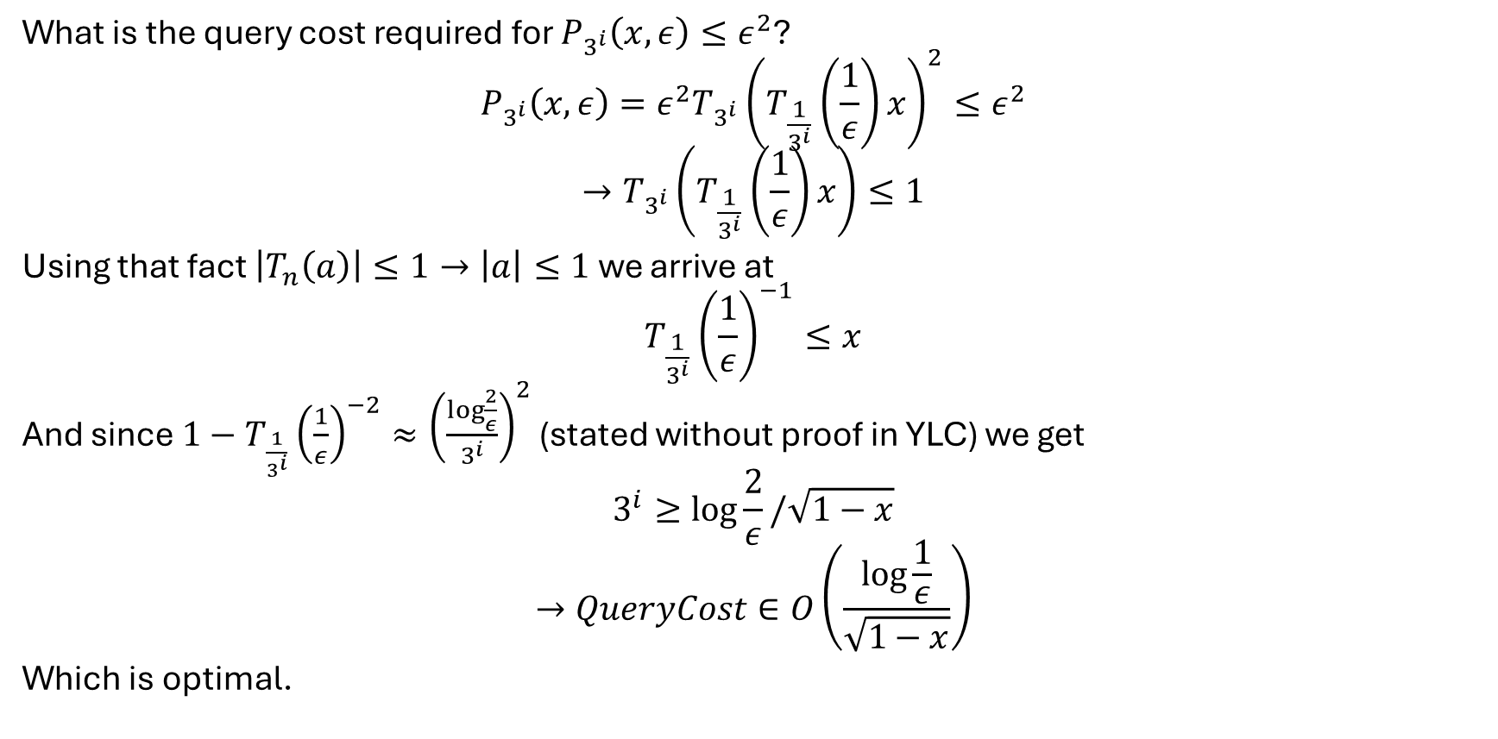
Solution: YLC FP search
What is the query cost required for $P_{3^{i}}\left(x,ε\right)≤ε^{2}$?
$$P_{3^{i}}\left(x,ε\right)=ε^{2}T_{3^{i}}{\left(T_{\frac{1}{3^{i}}}\left(\frac{1}{ε}\right)x\right)}^{2}≤ε^{2}$$
$$→T_{3^{i}}\left(T_{\frac{1}{3^{i}}}\left(\frac{1}{ε}\right)x\right)≤1$$
Using that fact $\left|T_{n}\left(a\right)\right|≤1→\left|a\right|≤1$ we arrive at
$$T_{\frac{1}{3^{i}}}{\left(\frac{1}{ε}\right)}^{−1}≤x$$
And since $1−T_{\frac{1}{3^{i}}}{\left(\frac{1}{ε}\right)}^{−2}≈{\left(\frac{\log{\frac{2}{ε}}}{3^{i}}\right)}^{2}$ (stated without proof in YLC) we get
$$3^{i}≥\log{\frac{2}{ε}}/\sqrt{1−x}$$
$$→QueryCost∈O\left(\frac{\log{\frac{1}{ε}}}{\sqrt{1−x}}\right)$$
Which is optimal.

Slide 15
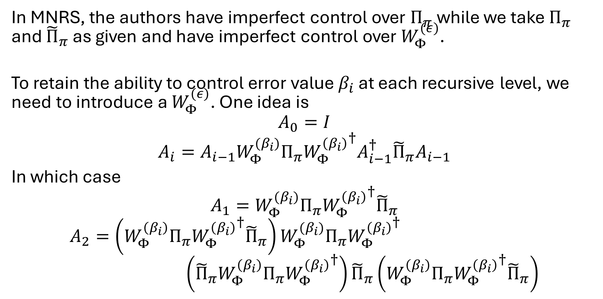
Complication 2
In MNRS, the authors have imperfect control over $Π_{π}$ while we take $Π_{π}$ and ${\tilde{Π}}_{π}$ as given and have imperfect control over $W_{Φ}^{(ε)}$.
To retain the ability to control error value $β_{i}$ at each recursive level, we need to introduce a $W_{Φ}^{(ε)}$. One idea is
$$A_{0}=I$$
$$A_{i}=A_{i−1}W_{Φ}^{{(β}_{i})}Π_{π}{W_{Φ}^{\left(β_{i}\right)}}^{†}A_{i−1}^{†}{\tilde{Π}}_{π}A_{i−1}$$
In which case
$$A_{1}=W_{Φ}^{(β_{i})}Π_{π}{W_{Φ}^{\left(β_{i}\right)}}^{†}{\tilde{Π}}_{π}$$
$$A_{2}=\left(W_{Φ}^{\left(β_{i}\right)}Π_{π}{W_{Φ}^{\left(β_{i}\right)}}^{†}{\tilde{Π}}_{π}\right)W_{Φ}^{(β_{i})}Π_{π}{W_{Φ}^{\left(β_{i}\right)}}^{†} \\ \left({\tilde{Π}}_{π}W_{Φ}^{\left(β_{i}\right)}Π_{π}{W_{Φ}^{\left(β_{i}\right)}}^{†}\right){\tilde{Π}}_{π}\left(W_{Φ}^{\left(β_{i}\right)}Π_{π}{W_{Φ}^{\left(β_{i}\right)}}^{†}{\tilde{Π}}_{π}\right)$$

